Slide 1
P10 Cracking the Code
A113 – Mathematics

Slide 2

Scenario
The police has discovered a time bomb in a building.
The remaining time before the bomb goes off is exactly 3 hours.
To deactivate the bomb, 2 sets of codes need to be cracked.
A
B
C
D
E
F
G
H
I

Slide 3
Scenario
Code 1:
There are 3 cards (red, green and blue). These cards have to be inserted into the 3 card slots in the correct arrangement.
…
Code 2:
There is an electronic keypad with 9 buttons.
Each time a button is pressed, the letter lights up and the button cannot be pressed again.
4 buttons need to be pressed in the correct combination.
The order in which the buttons are pressed does not matter.
A
B
C
A
B
C
A
B
C
…
D
E
F
D
E
F
D
E
F
G
H
I
G
H
I
G
H
I

Slide 4

Scenario
The cards need to inserted in the correct arrangement and the buttons need to be pressed in the correct combination at the same time to deactivate the bomb.
The time required to execute each set of Code 1 and Code 2 is 10 seconds.
Decide, with 3 hours remaining, if the police should attempt to crack the code or abandon the building.

Slide 5
Problem Definition Template
What do we know?
The remaining time before the bomb goes off is 3 hours
2 sets of codes are needed
etc
What do we not know?
The correct arrangement of cards to be inserted
The correct buttons to press on the keypad
etc
What do we need to find out?
Is there a systematic method to determine all the possible card arrangements and the time taken?
Will the bomb explode if the wrong codes are pressed?
etc

Slide 6
National Education
National Education Message:
“We must ourselves defend Singapore” – we are proud to defend Singapore ourselves, no one else is responsible for our security and well-being.
Terror threat in Singapore’s backyard is growing: Minister K Shanmugam
“A terror attack can take place any time, any place, and they can attack and impact on anyone — with a possibility of a loss of lives, within a short period of time, with little or no warning,” he said.

Slide 7
National Education
Question:
Discuss the threats of terrorism in Singapore. What are the precautions taken for these threats and how do we react in the event of one?

Slide 8
Learning Objectives
Construct a tree diagram to find the number of possible variations to a situation.
Apply the idea of permutation and combination to determine the number of possible outcomes in a given scenario.

Slide 9

Tree Diagram
Example:
Some of the ways we can arrange the letters ABCD are ACBD, BACD, CDAB. How many such variations are possible?
We can make use of the t to help us find the number of possible variations.

Slide 10
Tree Diagram
4
?
?
?
Position 1
Position 2
Position 3
Position 4
A
Initial Point
B
C
D
To place a letter in Position 1, we have 4 choices. Thus 4 branches can be extended from the initial point.

Slide 11
Tree Diagram
4
3
?
?
Position 1
Position 2
Position 3
Position 4
B
A
C
Initial Point
B
D
Same for the other 3 branches
C
D
To place a letter in Position 2, we are left with 3 choices. Thus, for each branch in Position 1, we can extend out another 3 branches.

Slide 12
Tree Diagram
4
3
2
?
Position 1
Position 2
Position 3
Position 4
C
B
A
D
C
Same for the other 2 branches
Initial Point
B
D
C
Same for the other 3 branches
D
To place a letter in Position 3, we are left with 2 choices. Thus, for each branch in Position 2, we can extend out another 2 branches.

Slide 13
Tree Diagram
4
3
2
1
Position 1
Position 2
Position 3
Position 4
C
D
B
A
D
Same for the other 1 branch.
C
Same for the other 2 branches
Initial Point
B
D
C
Same for the other 3 branches
D
Finally, to place a letter in Position 4, we are left with 1 choice. Thus for each branch in Position 3, we can extend out another 1 branch.

Slide 14
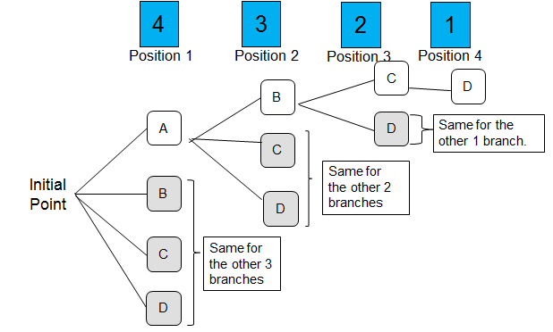




Tree Diagram
Total number of ways to arrange the 4 letters A,B,C,D
$$×$$
$$×$$
$$×$$
$$=$$
=
24
NOTE: (4 factorial) = 24

Slide 15

Arrangement without repetition
The number of ways to arrange n different objects
without repetition
=
= n! (pronounced as n factorial)
The calculator button or can be used to evaluate factorials.
n!
x!

Slide 16

Poll
Without using a calculator, can the following be evaluated?

Slide 17
Example
There are one red, one green, one blue, one yellow and one orange marble to be placed in five different containers C1, C2, C3, C4 and C5.
If every container is to contain only 1 marble, how many different ways can we arrange the marbles in the different containers?
R
G
B
Y
O
C1
C2
C3
C4
C5
Arrangement of 5 marbles without repetition:

Slide 18

Test Yourself 1
In how many different ways can a race with six runners be completed? Assume there is no tie.
Solution:

Slide 19
Test Yourself 2
In how many different ways can five people be seated in a row of five seats?
Solution:

Slide 20
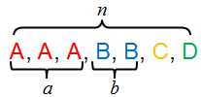
Arrangement with repetitions
Number of ways to arrange n different objects
with a repeated objects and b repeated objects

Slide 21
Example
There are two identical red and three identical yellow marbles to be placed in five different containers C1, C2, C3, C4 and C5.
If every container is to contain only 1 marble, how many different ways can we arrange the marbles into the different containers?
R
R
Y
Y
Y
C1
C2
C3
C4
C5
Arrangement of 5 marbles with repetition (2R and 3Y):

Slide 22
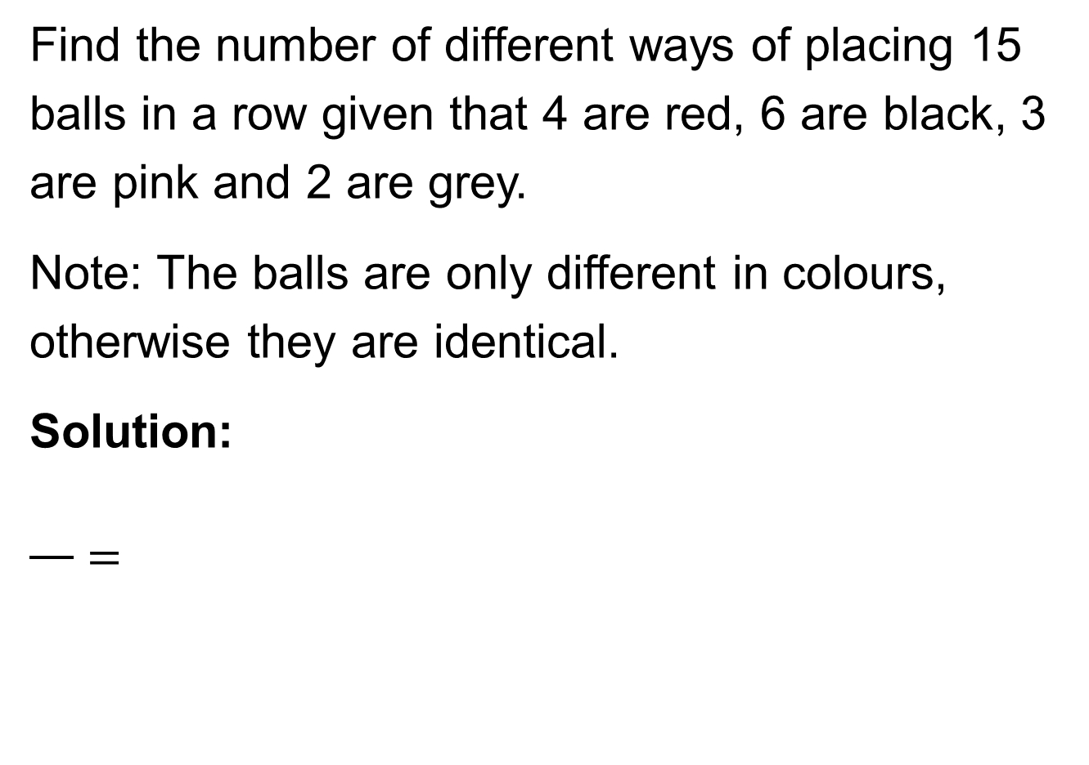
Test Yourself 3
Find the number of different ways of placing 15 balls in a row given that 4 are red, 6 are black, 3 are pink and 2 are grey.
Note: The balls are only different in colours, otherwise they are identical.
Solution:
$$\frac{}{}=$$

Slide 23

Test Yourself 4
How many ways can you arrange the letters in the word BANANA?
Solution:
$$\frac{}{}=$$

Slide 24
Arrangement with constraints
When k objects are fixed out of n different objects,
Number of ways to arrange

Slide 25
Example
There are one red, one green, one blue, one yellow and one orange marble to be placed in five different containers C1, C2, C3, C4 and C5.
If the red marble has to be placed in container C1,
how many different ways can we arrange the marbles into the different containers?
G
B
Y
O
C1
C2
C3
C4
C5
R
Since the position of 1 marble is fixed, we only arrange the 4 remaining marbles:

Slide 26
Test Yourself 5
There are one red, one green, one blue, one yellow and one orange marble to be placed in five different containers C1, C2, C3, C4 and C5.
If the red marble has to be placed in container C1 and the green marble has to be placed in container C3, how many different ways can we arrange the marbles into the different containers?
Solution:
B
Y
O
C1
C2
C3
C4
C5
R
G

Slide 27

Test Yourself 6
In how many ways can six students (including Donald) be seated in a row of six chairs if Donald insists on sitting on the first chair?
Solution:
Source: www.buzzfeed.com

Slide 28
Think Pair Share (5 min)
There are two identical red, two identical green, one blue, one yellow and one orange marble to be placed in seven different containers C1, C2, C3, C4, C5, C6 and C7.
If one of the red marbles has to be placed in container C3, how many different ways can we arrange the marbles into the different containers?
How will your answer to part a change, if there is a picture of a star printed on the blue marble and one of the green marbles?
R
G
G
B
Y
O
C1
C2
C3
C4
C5
C6
C7
R

Slide 29

Think Pair Share (5 min)
R
G
G
B
Y
O
C1
C2
C3
C4
C5
C6
C7
R
As the position of 1 marble is f , we only arrange the 6 remaining marbles. Since there is also a r ,
we have:
$$\frac{( )!}{!}=\frac{!}{!}=$$
Printing a picture of a star on one of the green marbles makes them . Hence, there is no . Printing the star on the blue marble makes no as there is only one blue marble.
We have:

Slide 30
Arrangement with groups
When different objects are grouped,
Number of ways to arrange
= (Number of groups)! (Number of objects in group 1)!
(Number of objects in group 2)! …

Slide 31
Example
There are one red, one green, one blue, one yellow and one orange marble to be placed in five different containers C1, C2, C3, C4 and C5.
If the red and green marbles have to be placed in containers next to each other, while the blue, yellow and orange marbles have to be placed in containers next to one another, how many different ways can we arrange the marbles into the different containers?
Group 1
Group 2
R
G
B
Y
O
C1
C2
C3
C4
C5
First arrange the grouped objects, then arrange within each group:

Slide 32

Test Yourself 7
Source: www.fotolia.com
In how many ways can nine different books be placed on a shelf if the five books A, E, I, O, U are to be placed next to each other and the other four books D, C, T, N are to be placed next to each other ?
Number of ways to arrange = (Number of groups)! (Number of objects in group 1)! (Number of objects in group 2)!

Slide 33
Test Yourself 8
In how many ways can nine different books be placed on a shelf if the two books A and E are to be placed next to each other?
Number of ways to arrange = (Number of groups)! (Number of objects in group 1)! (Number of objects in group 2)! ……
=

Slide 34
Permutation
A permutation is an ordered arrangement of a set of distinct objects. The order matters.
Permutation (Order matters)
Number of ways to choose r objects from a group of n
objects and arrange them
You can use the button in the calculator.
nPr

Slide 35
Example
Five coloured balls (red, green, blue, yellow, orange) are placed in a bag.
If we randomly pick out 3 balls from the bag and place them in different containers C1, C2 and C3, how many different ways can we pick and arrange the balls?
R
G
B
Y
O
C1
C2
C3
Order is important since the 3 balls are placed into different containers C1, C2 and C3, thus permutation is used.

Slide 36
Test Yourself 9
A club has nine members. In how many ways can a committee of three people for the positions of manager, treasurer and secretary be chosen?
Solution:

Slide 37
Test Yourself 10
A club has ten members. In how many ways can a committee of four people for the positions of manager, assistant manager, treasurer and secretary be chosen?
Solution:

Slide 38
Combination
A combination is a way of selecting r objects from a set of n distinct objects, such that the order of selection does not matter.
For example, we want to select 5 students from a class of 20 to participate in a competition. The order of how the students are selected is not important.
Combination (Order does not matter)
Number of ways to choose r objects from a group of n
objects
You can use the button in the calculator.
nCr

Slide 39
Example
Five coloured balls (red, green, blue, yellow, orange) are placed in a bag.
How many ways can we choose 3 balls from the bag?
Y
O
R
B
G
Order is not important in this question, thus combination is used.

Slide 40
Test Yourself 11
A club has nine members. In how many ways can a committee of three be chosen from the members of this club?
Solution:

Slide 41
Test Yourself 12
In how many ways can 3 pizza toppings be chosen from 12 available toppings?
Solution:

Slide 42
Learning Objectives
Construct a tree diagram to find the number of possible variations to a situation.
Apply the idea of permutation and combination to determine the number of possible outcomes in a given scenario.

Slide 43
One-Minute Write
Please produce a written response of either of the following in only one minute:
Identify what you feel, is the most confusing point from the seminar, or
Write down a question you have, with respect to the concepts learnt so far.

